Slide 1
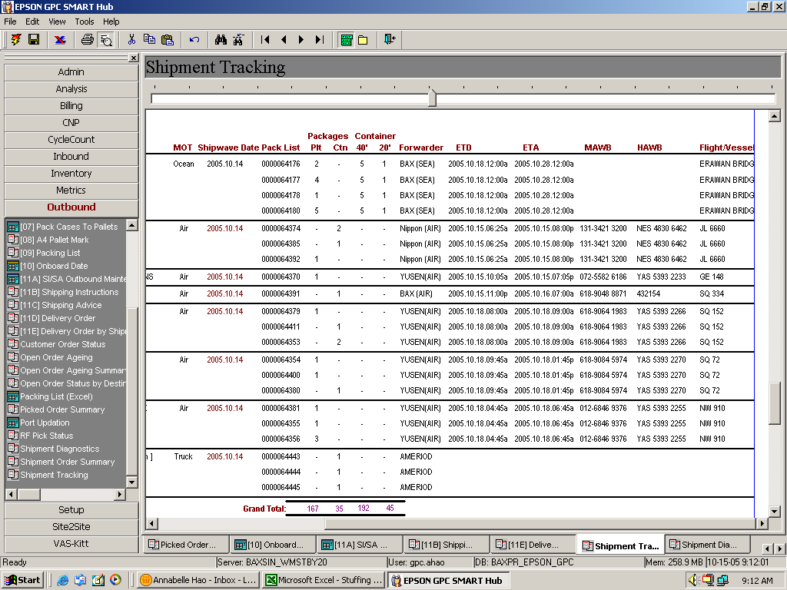
1. Pls squeeze a little bit more to show all vessel info;
2. Pls help to add 945 date provided there is enough space – last feedback to request take out is for the sake of saving space
Pls change to show once only for each shipment as it will affect Grand Total figure.
Pls change:
Forwarder
ETD
ETA
MAWB
HAWB
FLIGHT/VESSEL
back to its original appearance – show once only for each shipment
Thank you very much for adding in this summary data!

